Slide 1

DEPARTMENT OF COMPUTER ENGINEERING
AI-Based Student Monitoring (Group no : 10)
Student name: Namrata Narkhede. Roll no : 118 Division : B
Student name: Anupama Menon. Roll no : 106 Division : B
Student name: Itisha Mathane Roll no : 101 Division : B
Student name: Sayali Nikam Roll no : 120 Division : B
Under the Guidance of: Prof. S.S. Dange Ma’am

Slide 2
PROBLEM STATEMENT
The manual process of tracking student attendance is time-consuming and prone to errors, leading to incorrect attendance records. There is a need to improve parent engagement and keep them informed about their child's attendance.
Managing student attendance data can be challenging, and the existing solutions are often complex and difficult to use. Schools, colleges, and universities lack data-driven insights into student attendance, making it difficult to identify areas for improvement.
The AI-based student monitoring system aims to address these problems and provide a more efficient, secure, and user-friendly solution for tracking student attendance.
AI-Based Student Monitoring

Slide 3
OBJECTIVE
To automate the process of tracking student attendance, reducing the workload for teachers and administrators.
To provide a more accurate and up-to-date record of student attendance, reducing the risk of errors.
To improve parent engagement and keep them informed about their child's attendance.
To provide data-driven insights into student attendance, allowing colleges, and universities to identify areas for improvement.
To analyze student attendance data that will assist faculty in keeping student records.
AI-Based Student Monitoring

Slide 4
SCOPE
Manage student attendance data and provide up-to-date information on demand.
Generate reports and provide insights into student attendance, helping colleges, and universities to improve their attendance tracking processes.
Notifications and reports to parents, keeping them informed about their child's attendance. This can be implemented using email services
In the future scope , we would like to add recommendation feature for class advisor based on an analysis of student attendance.
We would like to integrate our face detection technology with our existing camera system in order to save time.
AI-Based Student Monitoring

Slide 5
FEATURES
User-friendly interface for admins to access the attendance database and for non-admins (parents) to check their child's attendance by mailing the attendance
Speed of the attendance recording process is faster
Develop a database for the Student Attendance.
2
4
6
1
3
5
7
Allow new students to store their faces in the database by using a GUI.
Able to show an indication to the user whether the face- recognition process is successful or not.
A portable, handy and self-powered Smart AI-Based Student Monitoring.
Accurate recognition of face from database
AI-Based Student Monitoring

Slide 6
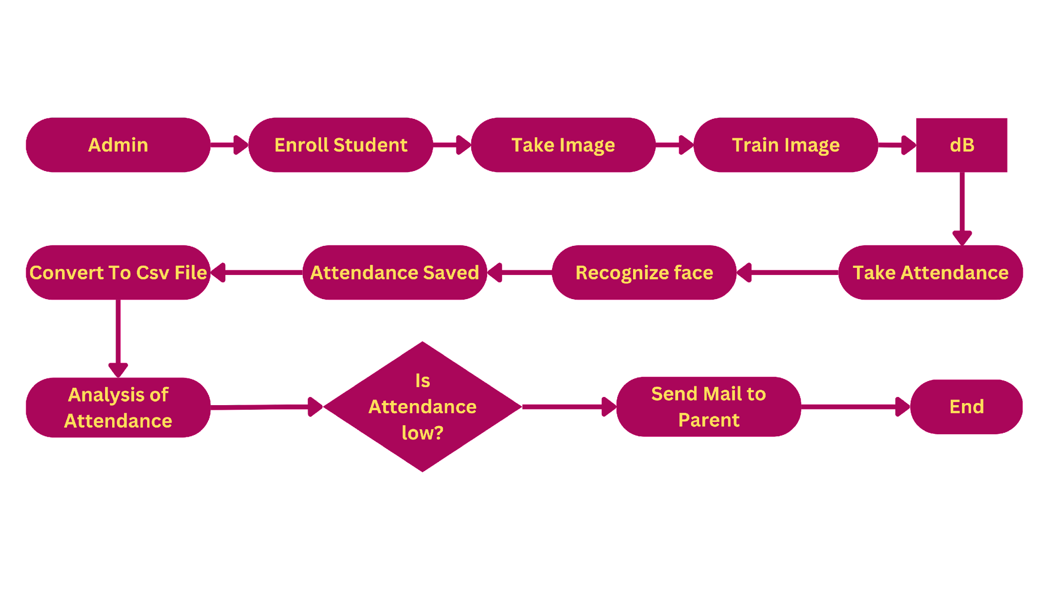
PROJECT FLOW
AI-Based Student Monitoring

Slide 7
TECHNOLOGY STACK
Front-end : A user-friendly interface for students and teachers to access the system and perform actions such as marking attendance and viewing reports. This is developed using technologies such as HTML, CSS and JavaScript.
Back-end : The core component of the system that handles data processing and storage. This can be built using programming languages such as Python and framework such as Flask or Django.
AI/ML Models : Advanced machine learning algorithms and models to perform facial recognition and attendance analysis. OpenCV library is used for this.
Email Services : To send notifications to parents, an email service such as SMTP is used to send emails.
AI-Based Student Monitoring

Slide 8
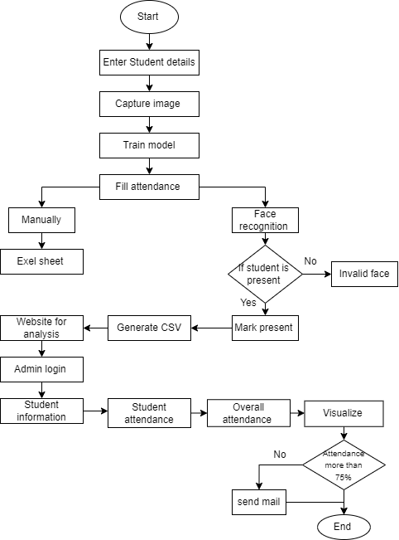
ACTIVITY DIAGRAM
AI-Based Student Monitoring

Slide 9
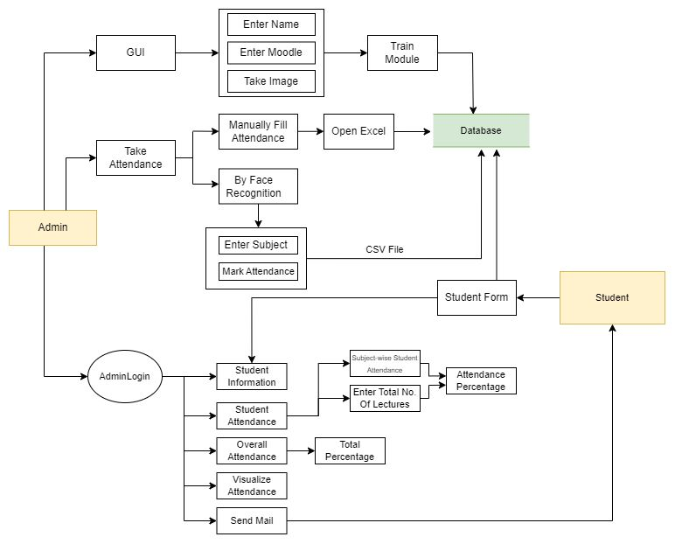
Architecture diagram
AI-Based Student Monitoring

Slide 10
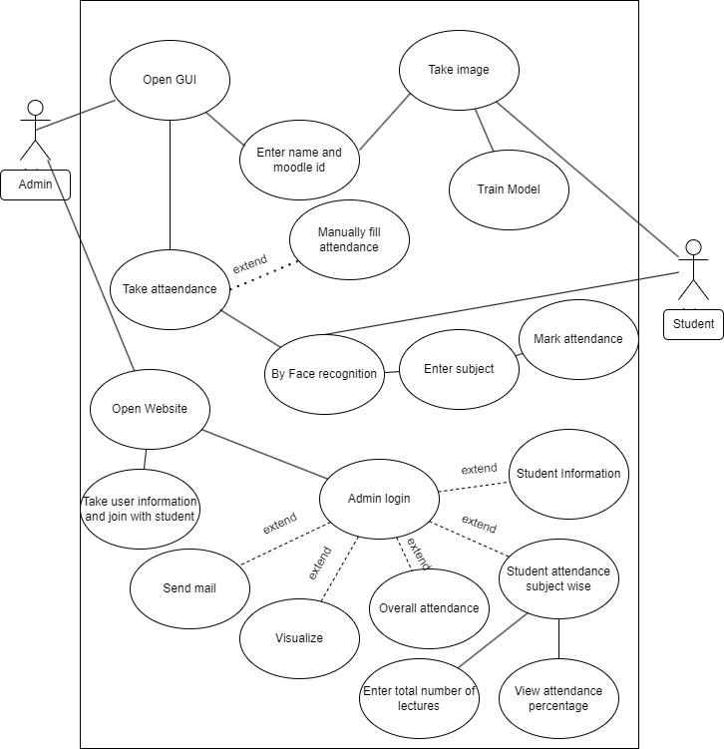
USE CASE DIAGRAM
AI-Based Student Monitoring

Slide 11
MODULES IMPLEMENTED(70%)
Face Recognition Module: This module would be responsible for capturing images of students as they enter the classroom and comparing them with the pre-existing database of student images to mark attendance.
Attendance Management Module : This module would store attendance data for each student for each subject, along with the corresponding date and time stamp.
Analysis Module : This module would perform analysis on the attendance data collected for each subject, such as calculating the percentage of attendance for each student, identifying students who are frequently absent, and generating reports on subject-wise attendance.
Overall Attendance Analysis Module: This module would provide an overview of the attendance data collected across all subjects, such as the overall attendance percentage of the attendance.
AI-Based Student Monitoring

Slide 12
MODULES PENDING(30%)
Visualization Module : This module would provide visual representations of the attendance data, such as graphs and charts, to help teachers and administrators quickly identify patterns and trends in student attendance.
Email Functionality Module : This module would enable teachers and administrators to send automated emails to students and their parents notifications about poor attendance.
Date-Wise Attendance and Sorting Module : In this module, attendance is shown according to date, and when total attendance is calculated, students with attendance rates below 75% are sorted from total attendance.
AI-Based Student Monitoring

Slide 13
REFERENCES
[1] "Face Recognition based Attendance System with Analysis" by N. Jaiswal and V. R. Singh ,International Journal of Computer Applications, Vol. 136, No. 2, February 2016
Link: https://www.researchgate.net/publication/303897666_Face_Recognition_based_Attendance_System_with_Analysis
[2] "Facial Recognition Based Attendance System Using Raspberry Pi" by S. P. Gaware and A. S. Mane, 2018 International Conference on Advances in Computing, Communications and Informatics (ICACCI), 2018
[3] "Smart Attendance Monitoring System Using Face Recognition and E-mail Notifications" by R. K. Saini and R. K. Aggarwal, IEEE International Conference on Computing, Communication and Automation (ICCCA), 2016
AI-Based Student Monitoring

Slide 14
THANK YOU

